Slide 1
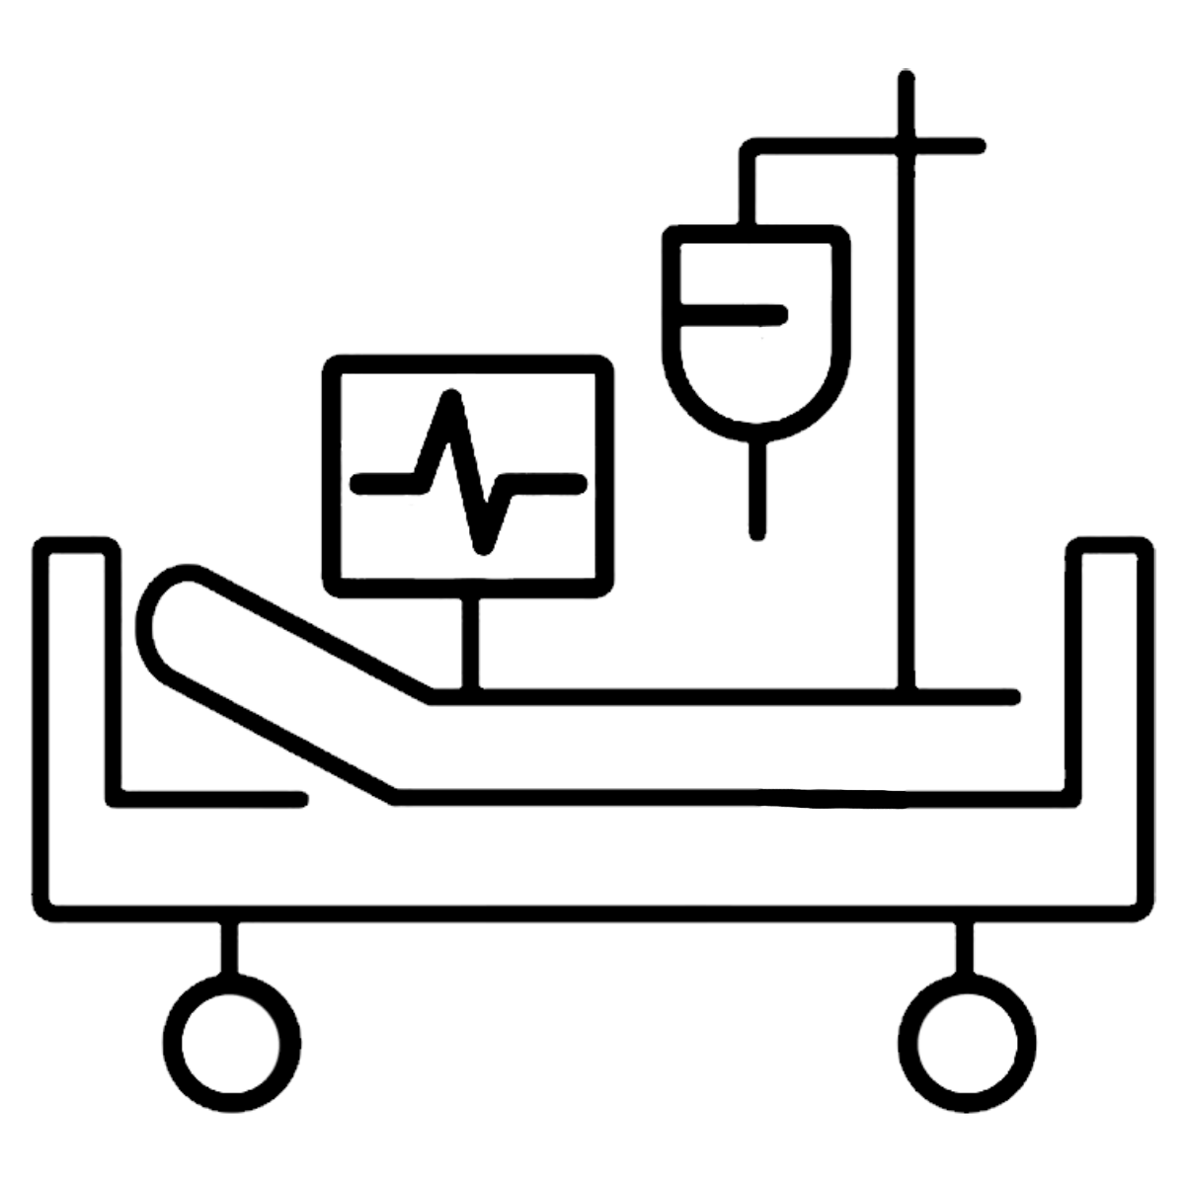
Acute Care
Special Interest Group
FREE for MAOT members!

Slide 2
Acute Care
Special Interest Group
Sunday, January 1
7:00 PM on Zoom
FREE for MAOT members!

